Slide 1

Pharmacokinetic / Pharmacodynamic analysis of experimental data
Data provided by Medicines for Malaria Venture
About me (briefly):
MSc Epidemiology Imperial College London 2014
PhD Liverpool School of Tropical Medicine 2019
Research portfolio:
Modelling drug treatment of malaria in simulated patients
Time course to treatment failure (recrudescence)
Accuracy of genotyping methods
Models of severe malaria pathology (sequestered parasites)
Consequences of antimalarial resistance
Simulation of insecticide deployment strategies
Sam Jones

Slide 2
Setting
Dosing combi..

Slide 3
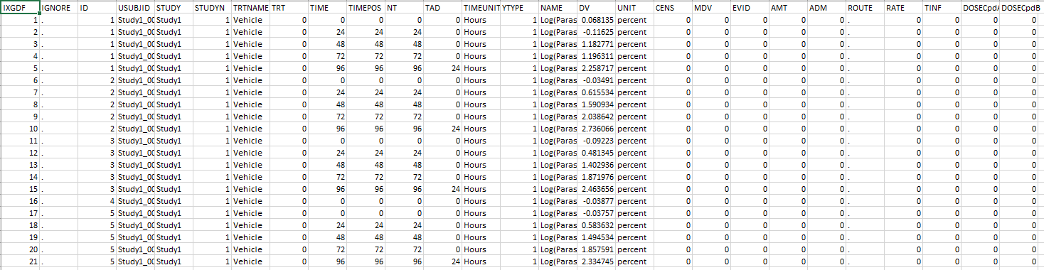

Provided with data-set…
Task:
“After a graphical analysis of the data, please provide the methodology you would use to build a PKPD model that helps understand the interaction between A and B. How would you then use this model to assess the efficacy of the combination in patients?”
Murine data – experiments conducted on mice
Clean up the data
Study 1
Study 2
Study 3
Visualize concentration and response
Compound A
Compound B
Compound A
Build pharmacokinetic models to describe drug concentration
Compound B
Build pharmacodynamic models to describe drug response
4 doses given of each drug: 0h, 24h, 48h, 72h
Measured:
Drug concentration
Response (change in number of parasitized erythrocytes)
Use a combined PK/PD model to predict the outcome of combination therapy in human patients

Slide 4

Methodology
All code written in R (version 4.0.3)
https://github.com/SamJ-28/PKPD
FileName.R
Indicates the file used in the analysis

Slide 5
Clean up the data
Visualize concentration and response
Note: concentration records below LLOQ were censored
Plotting.R
Functions.R

Slide 6
Clean up the data
Visualize concentration and response
Plotting.R
Functions.R

Slide 7
Clean up the data
Visualize concentration and response
Plotting.R
Functions.R

Slide 8
Clean up the data
Visualize concentration and response
Plotting.R
Functions.R

Slide 9
Cleaning up
Relate back to data
LLOQ

Slide 10
PK
Drug conc / dose.

Slide 11
Compartments

Slide 12
Fitting w software?

Slide 13
Parameter estimates example / predicted fit

Slide 14
Back to ODEs to predict what happens with alternate dose

